Slide 1


Traveler Smart Connected device
Nikola Janjusevic, DongKyu Kim,
Varouzan Knouni, Justin Jose

Slide 2
CUSTOMER SEGMENT

Slide 3

18 – 30 years old solo Backpackers who travel frequently

Slide 4
Value Proposition

Slide 5
- A Bluetooth or NFC enabled device that connects to a smartphone to track/locate multiple items simultaneously

Slide 6
Competition

Slide 7
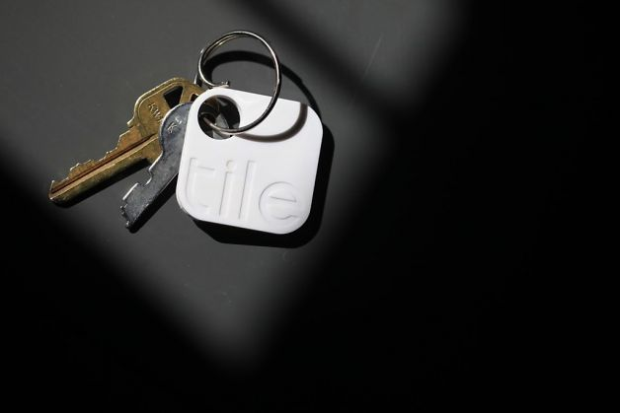
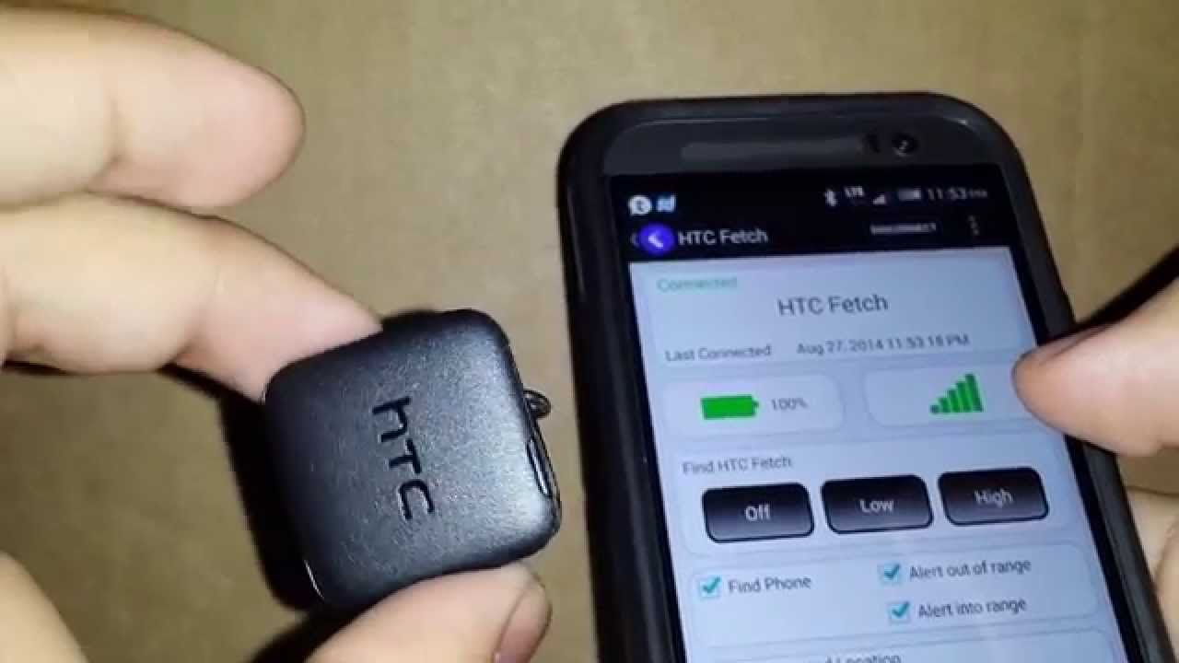
TILE
HTC
Fetch

Slide 8
What we learned from Interviews

Slide 10
Only 1 in 12 travelers interviewed were concerned about losing stuff

Slide 11
SO WHAT NOW?

Slide 12
We must change the value prop

